Slide 1


Foundations of Biostatistics II
DEPH 312 Principles of Scientific Evidence
Talal Alshihayb ^{BDS, DScD}
Diplomate, American Board of Dental Public Health
Assistant Professor
Department of Preventive Dental Science, College of Dentistry, King Saud bin Abdulaziz University for Health Sciences
Department of Health Policy and Health Services Research, Henry M. Goldman School of Dental Medicine, Boston University
December 25, 2023
shihaybt@ksau-hs.edu.sa

Slide 2
Recap
Study tasks
Measures of disease occurrence
Measures of association
Study designs
Validity and precision
Random and systematic errors in research
Causality and causal effects
Variables and their description

Slide 3


Types of variables
Qualitative (categorical)
Quantitative (numerical)
Nominal
Ordinal
Interval
Ratio

Slide 4
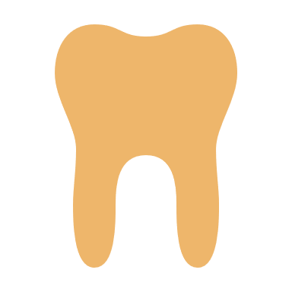

Quantitative (numerical)
Discrete (count)
Continuous
Integers only (no decimals)
Can have decimals

Slide 5
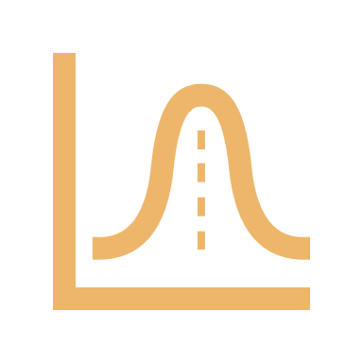
Distribution
We are interested in how the observations are distributed
But what is a distribution?
How frequently the different values occur

Slide 6
Describing categorical variables
Let’s say I want to know the distribution of having diabetes among your batch. How can we describe this variables?
Diabetic
Non-diabetic
%
%

Slide 7
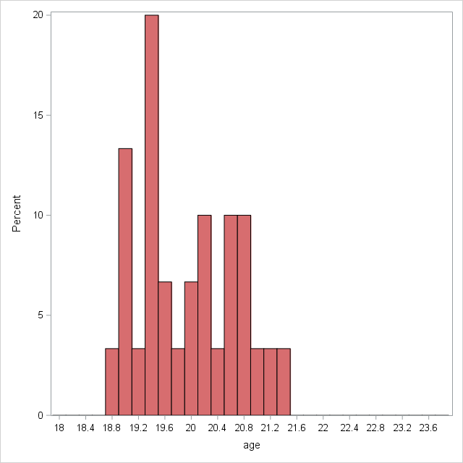
Summarizing a distribution
Mean is a measure of central tendency
Produces a representative value
Mean age is 19.9
Is this information enough to accurately describe the distribution well?

Slide 8
Summarizing a distribution Mean VS. Median
Median is used
If you want to describe a typical observation
If you have highly skewed data with few extreme values (outliers)
Remember the example of Jeff Bezos and wealth (if you calculate mean, it would be very high but if you exclude Jeff Bezos, it would drop sharply)
Mean is sensitive to extreme values
Why use the mean then?
Has nice properties
Easier to work with mathematically (is in a lot of statistical calculations)
Sometimes you do want a representative value (not a representative observation)
Right skew
Left skew
The effect: An Introduction to Research Design and Causality by Nick Huntington-Klein https://theeffectbook.net/

Slide 9
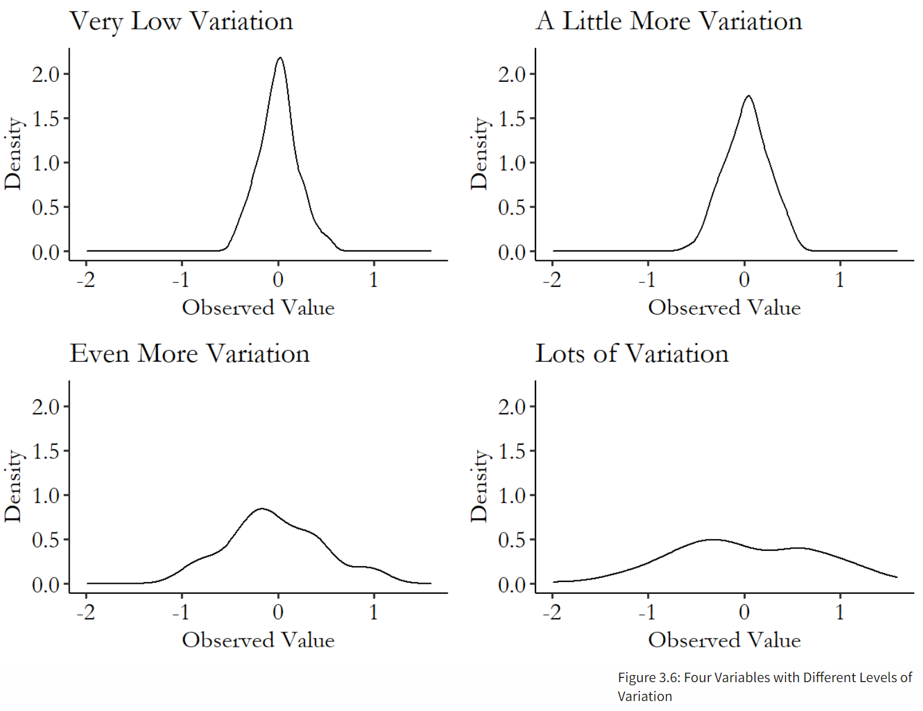
The effect: An Introduction to Research Design and Causality by Nick Huntington-Klein https://theeffectbook.net/

Slide 10
We need
A measure of variation also (measures of dispersion)
Variance (or standard deviation)
Median absolute deviation
Inter-quartile range
Etc.

Slide 11

LECTURE LEARNING OUTCOMES OF EACH OF THE DIDACTIC SESSIONS
REFERENCE:
Chapter 3 in The effect: An Introduction to Research Design and Causality by Nick Huntington-Klein https://theeffectbook.net/
LECTURE LEARNING OUTCOMES:
Describe the measures of dispersion.
Describe the different probability distributions.

Slide 12
Measures of dispersion
Variance (or standard deviation)
Range
Interquartile range

Slide 13
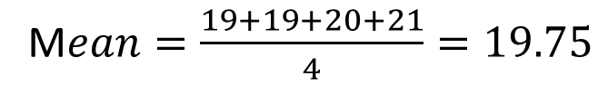
Back to our example
Age of a population of 4 people
19 19 20 21
M$ean=\frac{19+19+20+21}{4}=19.75$
Age | Frequency | Percentage | Weight | Age * weight
19 | 2 | 50% | 2/4=0.5 | 9.5
20 | 1 | 25% | 1/4=0.25 | 5
21 | 1 | 25% | 1/4=0.25 | 5.25
Total | 4 | 100% | 4/4=1 | 19.75
Scale each different/unique value by how likely you are to get it

Slide 14
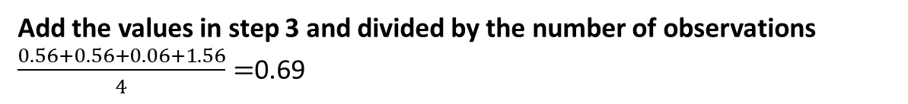
Population variance
Ages of a population of 4 people
19 19 20 21
1
Calculate m$ean=\frac{19+19+20+21}{4}=19.75$
Subtract the mean from each value
19 - 19.75, 19 - 19.75, 20 - 19.75, 21 - 19.75
-0.75, -0.75, 0.25, 1.25
2
3
Square the values in step 2
0.56, 0.56, 0.06, 1.56
4
Add the values in step 3 and divided by the number of observations
$\frac{0.56+0.56+0.06+1.56}{4}=$0.69

Slide 15
Population variance
Ages of a population of 4 people
19 19 20 21
1
Calculate m$ean=\frac{19+19+20+21}{4}=19.75$
Subtract the mean from each value
19 - 19.75, 19 - 19.75, 20 - 19.75, 21 - 19.75
-0.75, -0.75, 0.25, 1.25
2
3
Square the values in step 2
0.56, 0.56, 0.06, 1.56
Why square?
4
Add the values in step 3 and divided by the number of observations
$\frac{0.56+0.56+0.06+1.56}{4}=$0.69

Slide 16





Population
Sample
Because of limited
We want to get the distribution in the population (mean and variance)
We get the distribution in the sample (mean and variance)
Hope to approximate the population

Slide 17
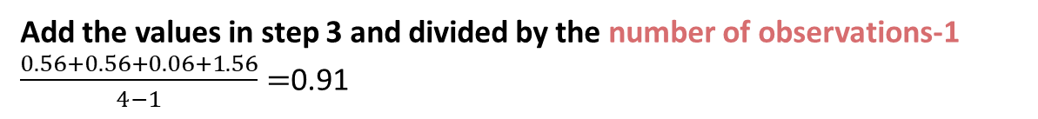
Sample variance
Ages of a sample of 4 people (out of a larger population)
19 19 20 21
1
Calculate m$ean=\frac{19+19+20+21}{4}=19.75$
Subtract the mean from each value
19 - 19.75, 19 - 19.75, 20 - 19.75, 21 - 19.75
-0.75, -0.75, 0.25, 1.25
2
3
Square the values in step 2
0.56, 0.56, 0.06, 1.56
4
Add the values in step 3 and divided by the number of observations-1
$\frac{0.56+0.56+0.06+1.56}{4−1}=$0.91
Why divide by n of observations-1?

Slide 18
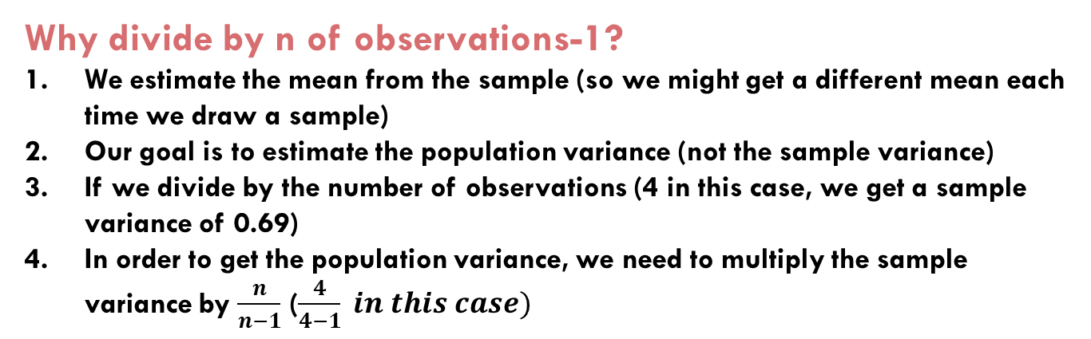
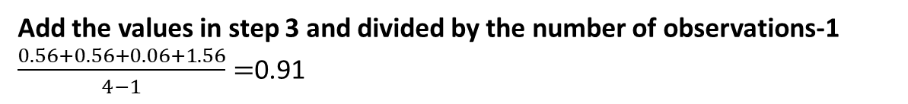
Sample variance
Why divide by n of observations-1?
We estimate the mean from the sample (so we might get a different mean each time we draw a sample)
Our goal is to estimate the population variance (not the sample variance)
If we divide by the number of observations (4 in this case, we get a sample variance of 0.69)
In order to get the population variance, we need to multiply the sample variance by $\frac{n}{n−1}$ ($\frac{4}{4−1} in this case)$
Ages of a sample of 4 people (out of a larger population)
19 19 20 21
1
Calculate m$ean=\frac{19+19+20+21}{4}=19.75$
$$\frac{0.56+0.56+0.06+1.56}{4} ∗ \frac{4}{4−1}=\frac{0.56+0.56+0.06+1.56}{4−1}$$
Subtract the mean from each value
19 - 19.75, 19 - 19.75, 20 - 19.75, 21 - 19.75
-0.75, -0.75, 0.25, 1.25
2
3
Square the values in step 2
0.56, 0.56, 0.06, 1.56
4
Add the values in step 3 and divided by the number of observations-1
$\frac{0.56+0.56+0.06+1.56}{4−1}=$0.91

Slide 19
Back to your batch age example
18.8 18.9 18.9 19.0 19.0
19.1 19.3 19.3 19.3 19.3
19.4 19.4 19.5 19.6 19.7
19.9 20.0 20.1 20.2 20.2
20.3 20.5 20.5 20.5 20.7
20.8 20.8 21.0 21.1 21.4
Mean=(18.8+18.9+18.9+19+19+19.1+19.3+19.3+19.3+19.3+19.4+19.4+19.5+19.6+19.7+19.9+20+20.1+20.2+20.2+20.3+20.5+20.5+20.5+20.7+20.8+20.8+21+21.1+21.4) / 30=19.9
Subtract the mean from every single value
Square it
Divide by the number of observations (30 because it is a population)
Population variance=0.54

Slide 20
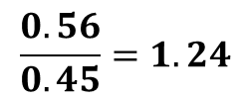
I sampled 5 of you and calculated the mean age and sample variance
Sampling trial (sample 5 people every time/row) | Population variance (doesn’t change) | Sample variance | Bias correction (n/n-1) | Corrected sample variance (sample variance * (n/n-1))
1 | 0.54 | 0.59 | 5/4=1.25 | 0.74
2 | 0.54 | 0.70 | 5/4=1.25 | 0.88
3 | 0.54 | 0.61 | 5/4=1.25 | 0.76
4 | 0.54 | 0.56 | 5/4=1.25 | 0.70
. | . | . | . | .
. | . | . | . | .
. | . | . | . | .
500 | 0.54 | 0.26 | 5/4=1.25 | 0.32
Average | 0.54 | 0.45 | 5/4=1.25 | 0.56
$$\frac{0.56}{0.45}=1.24$$

Slide 21
Variance
Mean of squared distance from the mean
Same problem with the mean
Sensitive to extreme values
Values very far from the mean have large squared distances
Remember Jeff Bezos

Slide 22
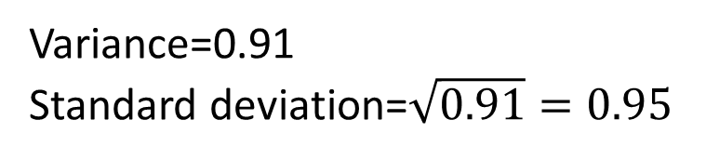
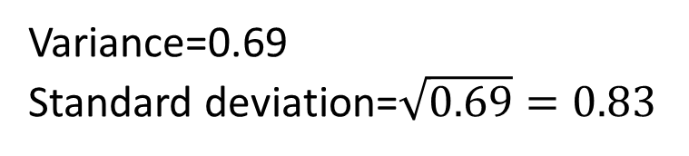
Interpretation of the variance
Squared units (squared age in our case)
Difficult to interpret
Convert to standard deviation by taking squared root
Get original units (age in our case)
Population
Sample
Variance=0.91
Standard deviation=$\sqrt{0.91}=0.95$
Variance=0.69
Standard deviation=$\sqrt{0.69}=0.83$

Slide 23
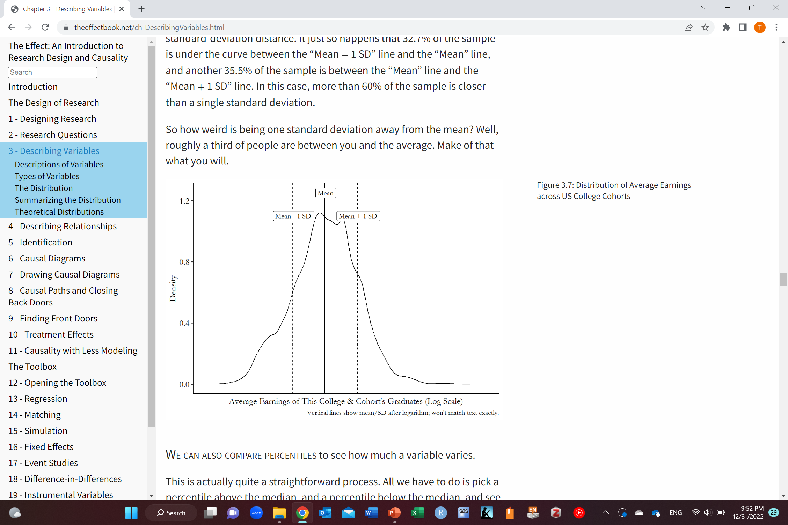
Getting sense of standard deviation
32.7% of data under the curve
35.5% of data under the curve
The effect: An Introduction to Research Design and Causality by Nick Huntington-Klein https://theeffectbook.net/

Slide 24
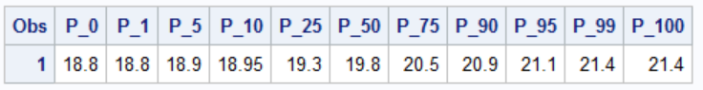
Range
0th percentile
Minimum value
100th percentile
Maximum value
Median
The person right in the middle
Half the batch is younger than him/her and half is older

Slide 25
Range
Affected by extreme values
Remember Jeff Bezos

Slide 26
Interquartile range (IQR)
25th percentile
75th percentile
Median
The person right in the middle
Half the batch is younger than him/her and half is older

Slide 27
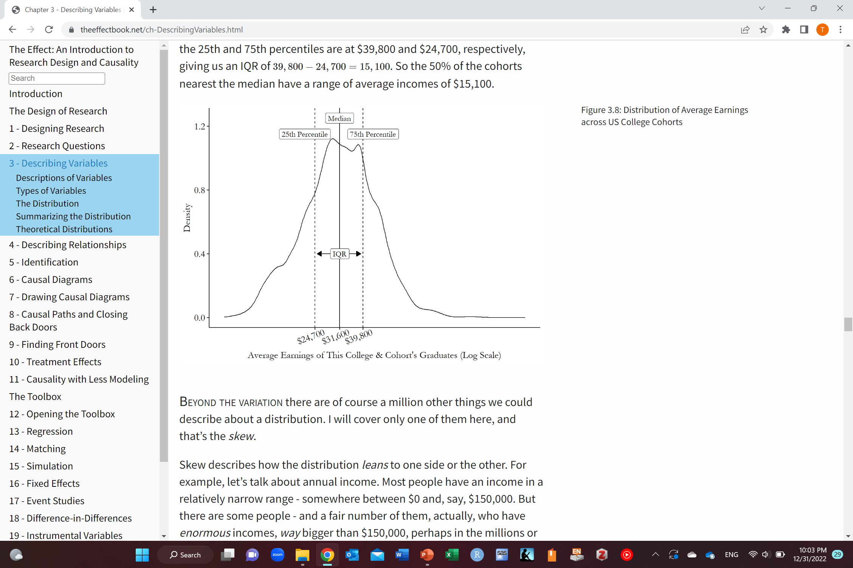
Interquartile range (IQR)
$39,800-$24,700=$15,100
50% of the sample nearest the median have a range of $15,100
The effect: An Introduction to Research Design and Causality by Nick Huntington-Klein https://theeffectbook.net/

Slide 28
Interquartile range (IQR)
Covers half of the sample (half closest to the median)
Sense of how close to median
Not sensitive to extreme values
Represents observations (not values)

Slide 29
Skewness
Right skew
Symmetric
Normal distribution
Left skew

Slide 30
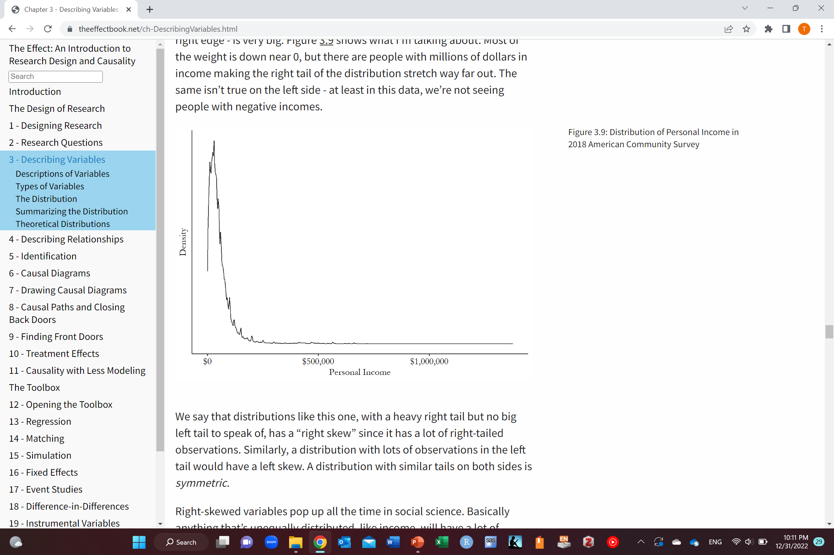
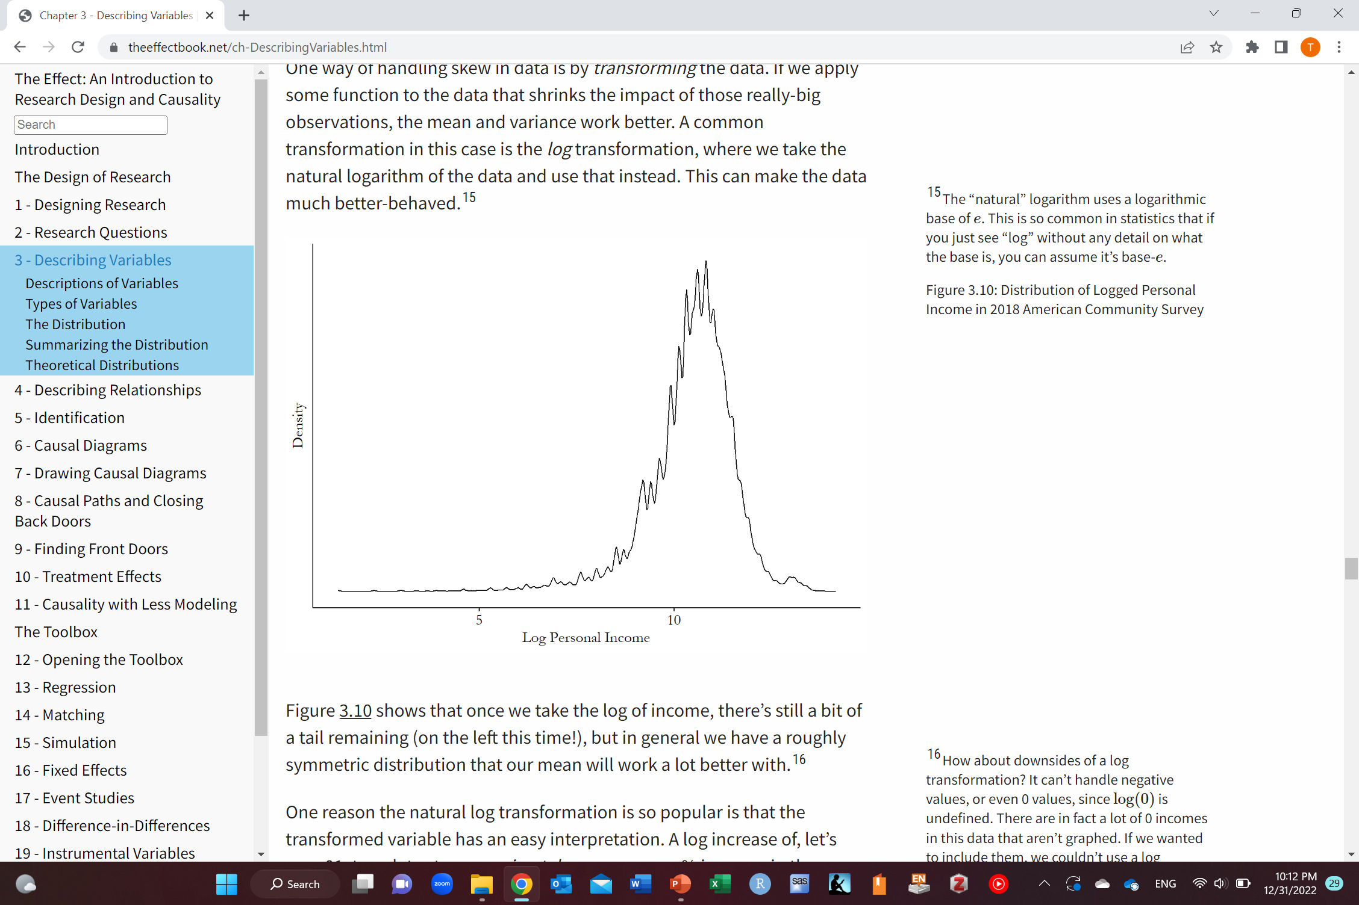
Solution to Skewness
Data transformation
The effect: An Introduction to Research Design and Causality by Nick Huntington-Klein https://theeffectbook.net/

Slide 31
Theoretical distributions
Truth
Data
Theoretical distribution
Observed distribution

Slide 32
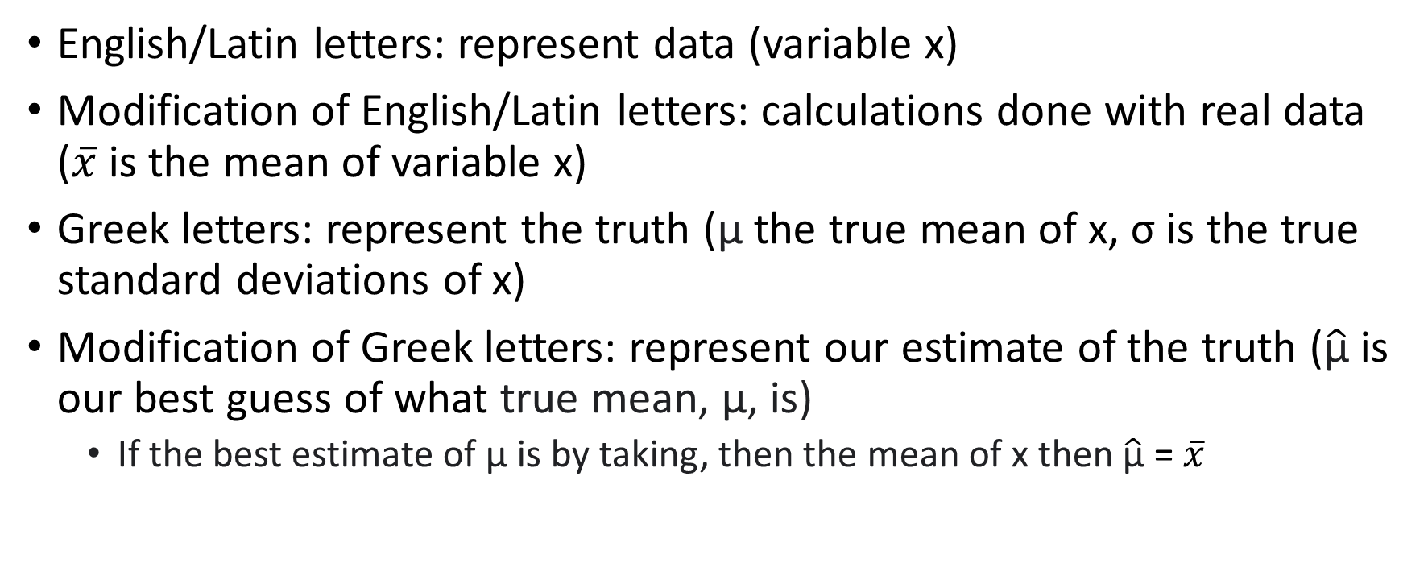
Notations
English/Latin letters: represent data (variable x)
Modification of English/Latin letters: calculations done with real data ($\overline{x}$ is the mean of variable x)
Greek letters: represent the truth (µ the true mean of x, σ is the true standard deviations of x)
Modification of Greek letters: represent our estimate of the truth ($\hat{\text{µ}}$ is our best guess of what true mean, µ, is)
If the best estimate of µ is by taking, then the mean of x then $\hat{\text{µ}}$ = $\overline{x}$

Slide 33
Theoretical distributions
What gave rise to your data
The distribution of all the data (even the ones you did not observe)

Slide 34
Population
Sample
Because of limited
We want to get the distribution in the population (mean and variance)
We get the distribution in the sample (mean and variance)
Hope to approximate the population

Slide 35
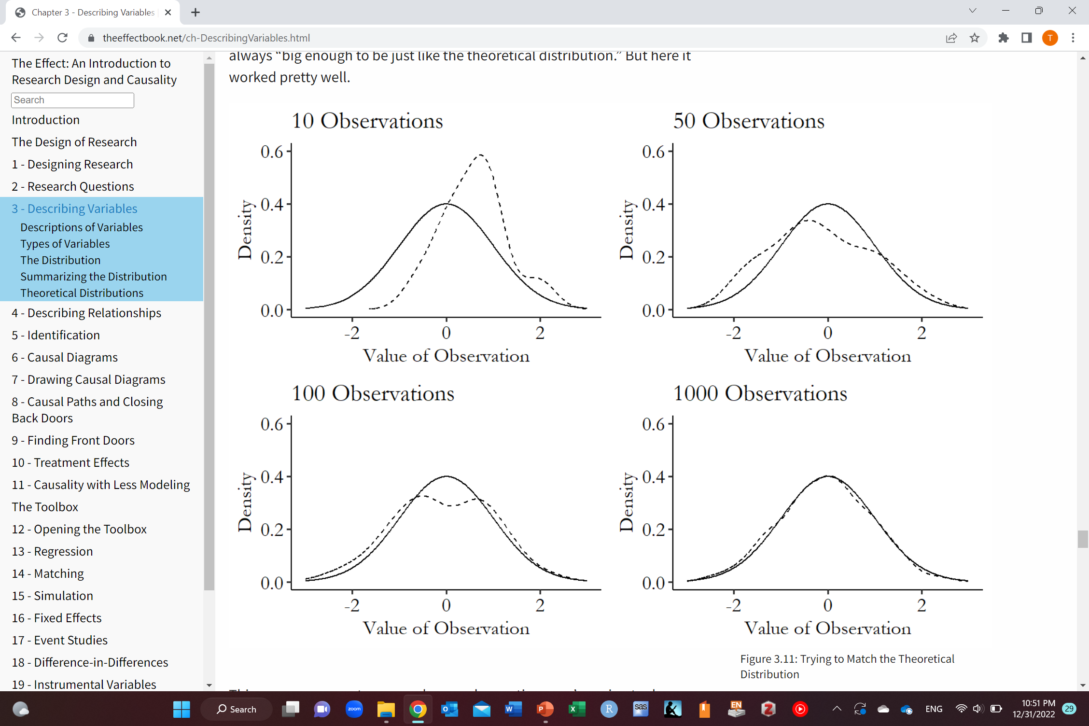

Theoretical distributions
The effect: An Introduction to Research Design and Causality by Nick Huntington-Klein https://theeffectbook.net/

Slide 36
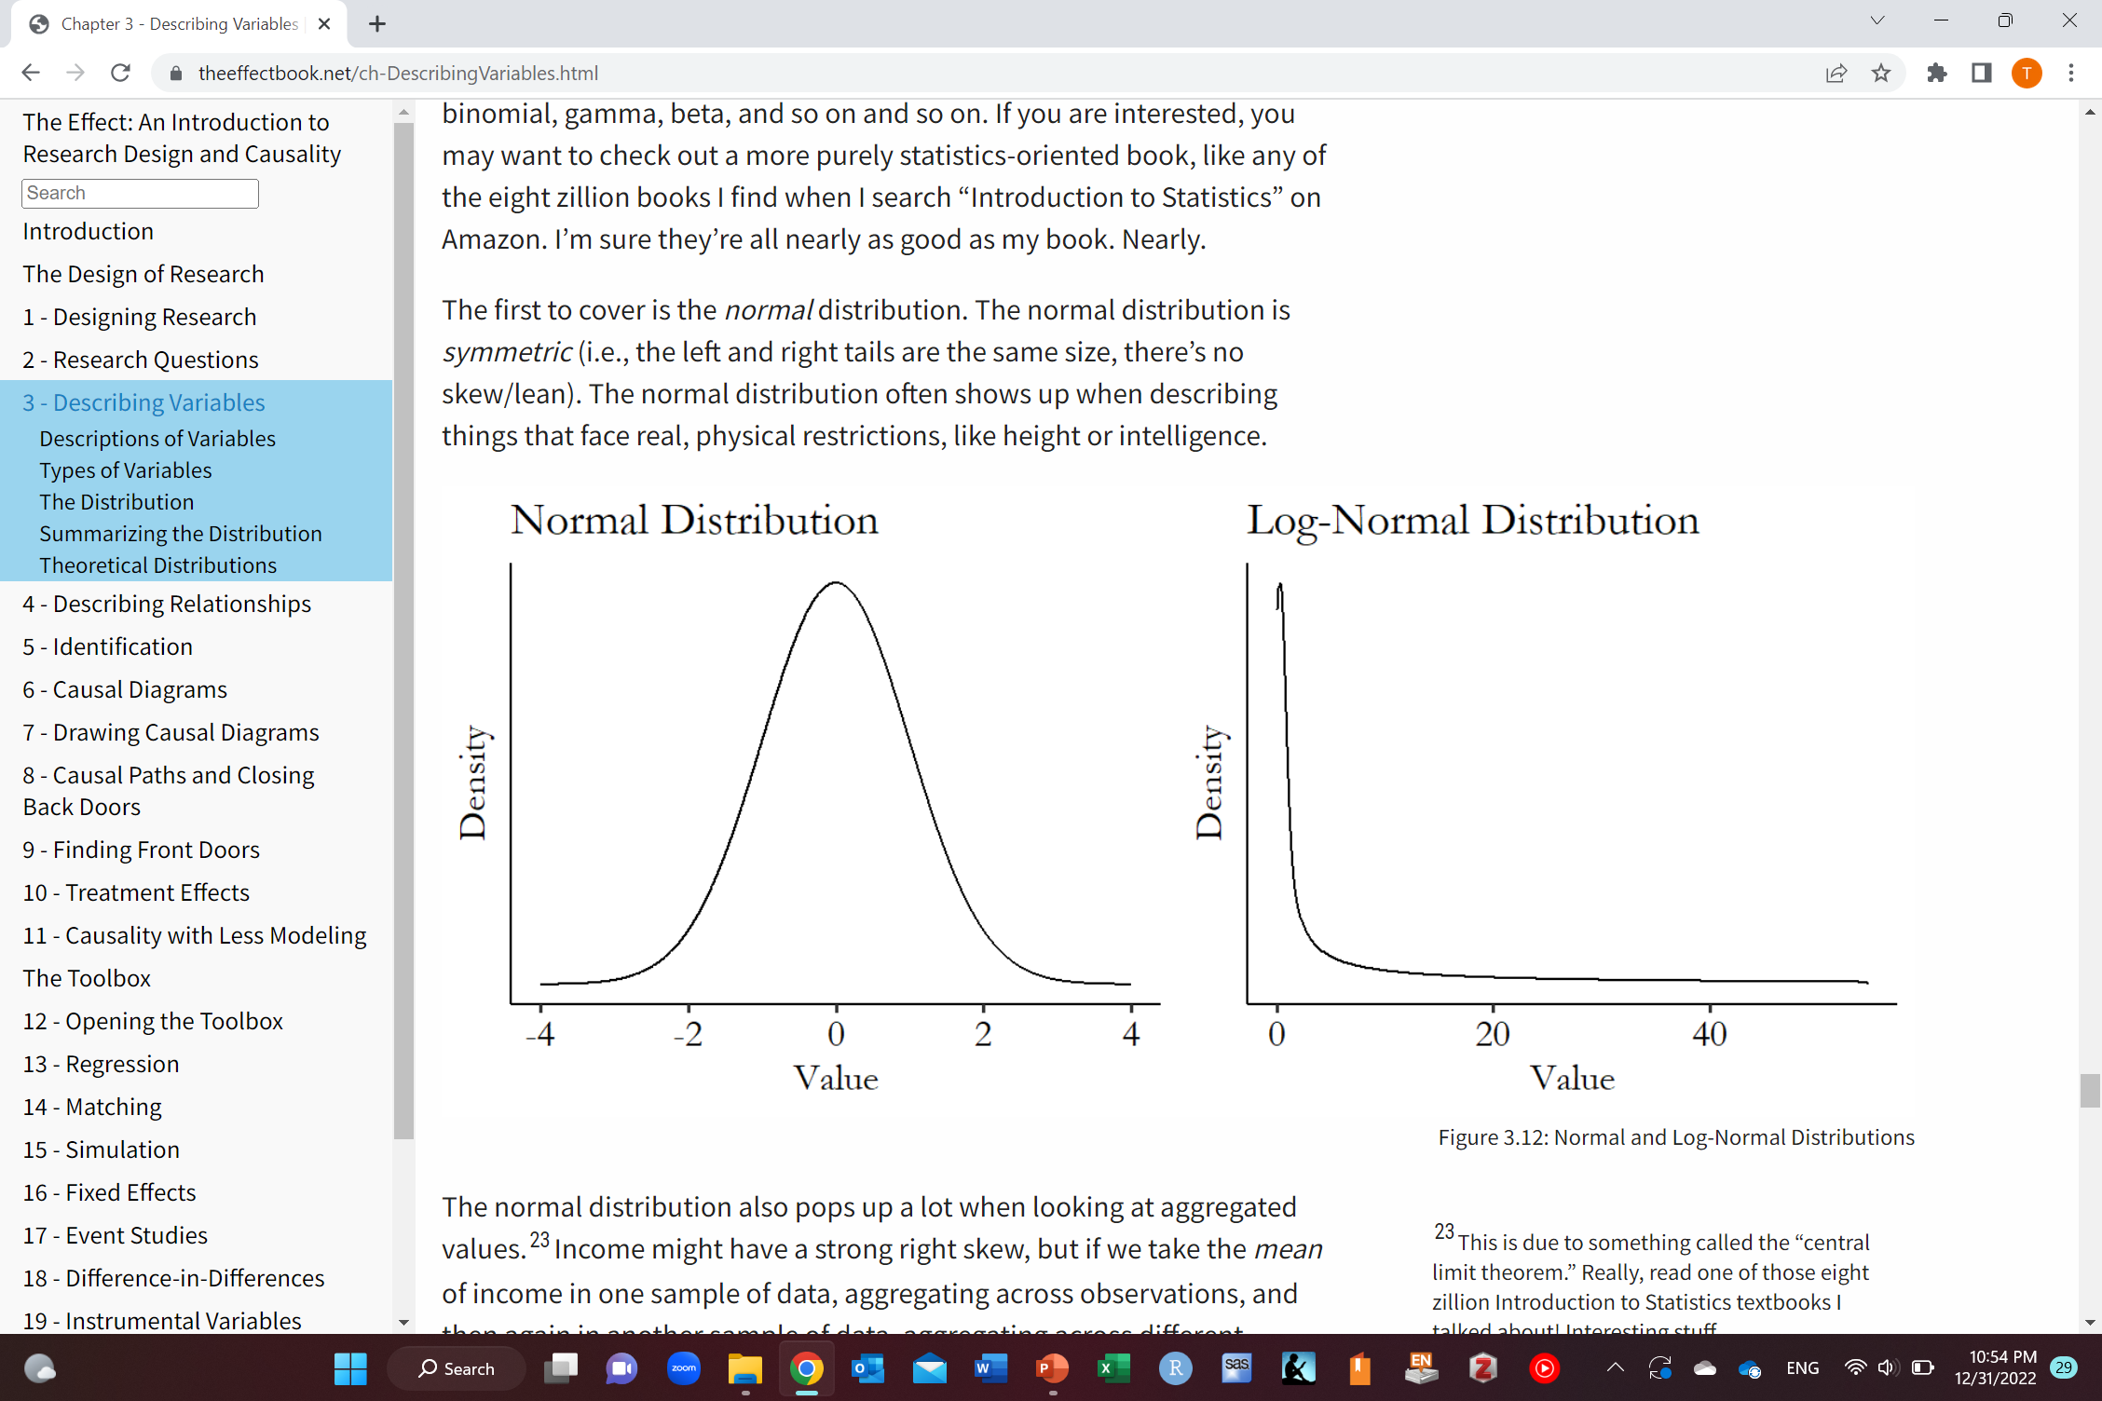
Types of theoretical distributions
The effect: An Introduction to Research Design and Causality by Nick Huntington-Klein https://theeffectbook.net/

Slide 37
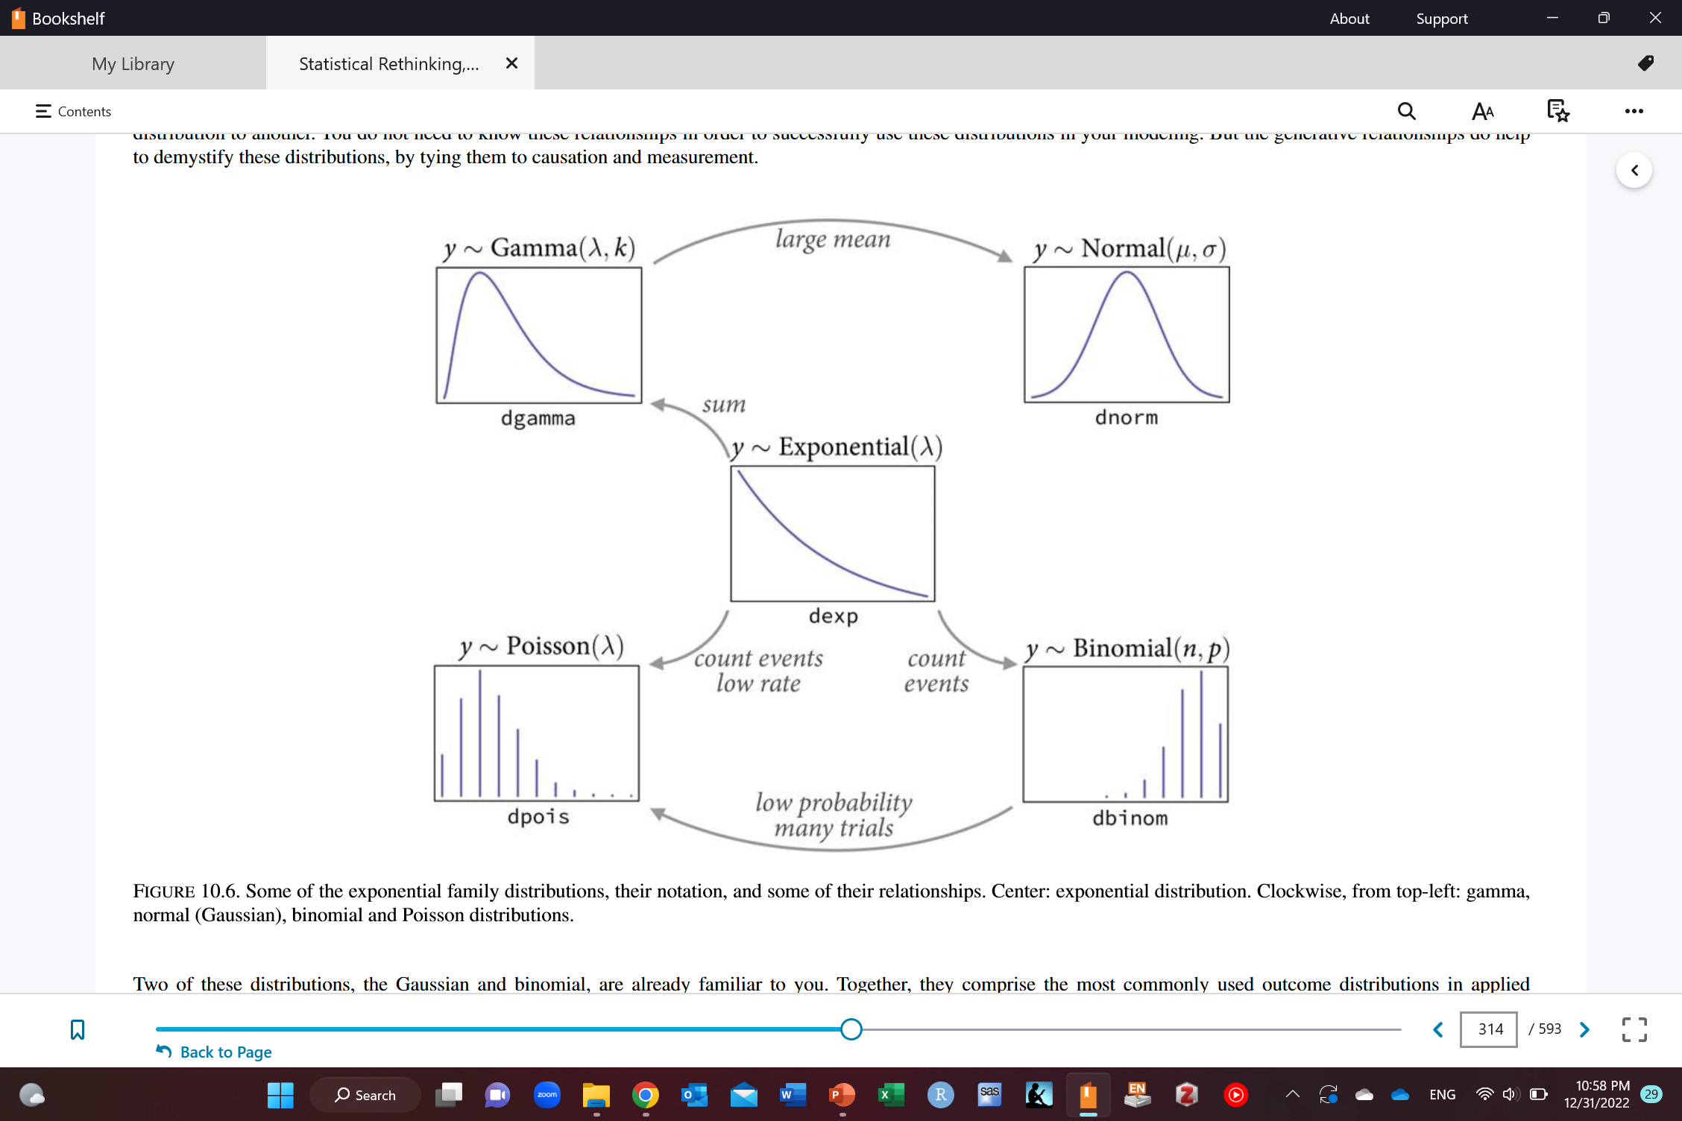
McElreath R. Statistical rethinking: A Bayesian course with examples in R and Stan. CRC press; 2020 Mar 13.

Slide 38
Normal distribution
Aggregate values
Income may be right skewed (Jeff Bezos)
If we calculate mean in one sample of data
Do it again
The distribution of the mean across the sample would have a normal distribution
Central limit theorem

Slide 39
Using data to learn about a theoretical distribution
Choose some description of the theoretical distribution (mean, median, standard deviation, etc.)
Use properties of the theoretical distribution and your sample size to find the theoretical distribution of that description in random samples (means follow a normal distribution)
Make that same description of your observed data
Use theoretical distribution of that description to find how unlikely it would be to get the data you got
If the theoretical distribution has a mean of 1 and a standard deviation of 2 and we got a mean of 1.5 in our data
“How likely is it that we would get 1.5 or more from a normal distribution with a mean of 1 and a standard deviation of 2?”
The effect: An Introduction to Research Design and Causality by Nick Huntington-Klein https://theeffectbook.net/

Slide 40
Using data to learn about a theoretical distribution
If it is unlikely, then you probably started with the wrong distribution and can rule it out
The effect: An Introduction to Research Design and Causality by Nick Huntington-Klein https://theeffectbook.net/

Slide 41
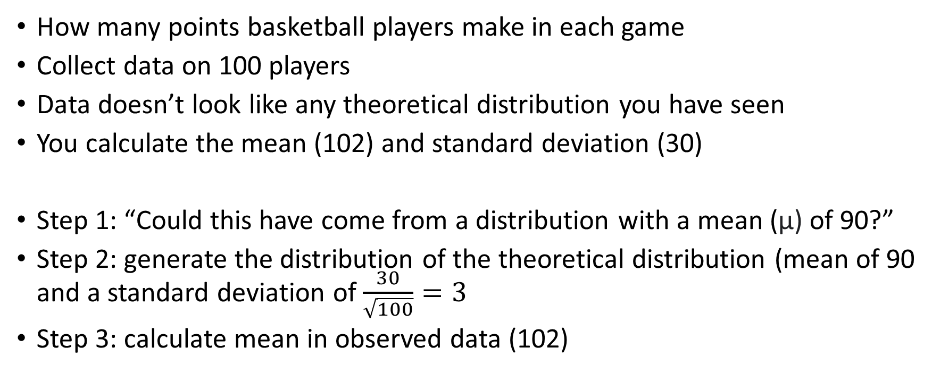
An example by Nick Huntington-Klein
How many points basketball players make in each game
Collect data on 100 players
Data doesn’t look like any theoretical distribution you have seen
You calculate the mean (102) and standard deviation (30)
Step 1: “Could this have come from a distribution with a mean (µ) of 90?”
Step 2: generate the distribution of the theoretical distribution (mean of 90 and a standard deviation of $\frac{30}{\sqrt{100}}=3$
Step 3: calculate mean in observed data (102)
The effect: An Introduction to Research Design and Causality by Nick Huntington-Klein https://theeffectbook.net/

Slide 42
An example by Nick Huntington-Klein
Step 4: “how likely is it to get a 102 or even more from a normal distribution with mean 90 and standard deviation of 3?”
How likely to get a mean of 102 or more or a mean of 78 or less
If we check percentiles
78 is 0.004th percentile (0.004% chance or less of getting a mean of 78 or less)
102 is 99.996th percentile (0.004% chance or less of getting a mean of 102 or more)
Step 5: add the two chances together
0.008% chance of getting a mean as far off as 102 or more if the true mean is 90 and the true standard deviation is 30
It is pretty unlikely (this data very likely did not come from a distribution with a mean of 90)
The effect: An Introduction to Research Design and Causality by Nick Huntington-Klein https://theeffectbook.net/

Slide 43
Any Questions?
shihaybt@ksau-hs.edu.sa

